Slide 1

Enterprise Integration
LIX Encontro da Comunidade SQLPort
Sandro Pereira
Senior Software Developer
Microsoft Integration MVP

Slide 2


Sandro Pereira
Senior Software Developer at DevScope
Microsoft Integration MVP since 2011
Member and co-founder of BizTalkCrew – BizTalk Innovation Day Events
Writer of numerous articles for Portuguese eMagazine “Programar”
Author “Sandro Pereira BizTalk Blog” http://sandroaspbiztalkblog.wordpress.com
Member of “BizTalkAdminsblogging.com” and “BizTalk Brasil” community
Member NetPonto community, MSDN BizTalk Forums Moderator
TechNet Wiki author (Wiki Ninja)
TechNet Gallery, Code Gallery and CodePlex contributor
Public speaker
Technical Reviewer PACKT Publishing
BizTalk Server 2010 Cookbook (April 2012)
Author book: BizTalk Mapping Patterns and Best Practices

Slide 3



12 Mapper Patterns
365 pages
4 Technical Reviewers
Steef-Jan Wiggers, Nino Crudele, Michael Stephenson, José António Silva
FREE BOOK!
http://www.biztalk360.com/biztalk-mapping-patterns/
BizTalk Mapping Patterns and Best Practices
Sandro Pereira
brought to you by

Slide 4
Agenda
Enterprise Integration
Concepts and challenges
Introduction to BizTalk Server
What is? What does BizTalk do?
Introduction to BizTalk Services
What is? What does BizTalk do?

Slide 5
integration
Integration (from the Latin integer, meaning whole or entire) generally means combining parts so that they work together or form a whole.
Notes:
Nowadays system have to be linked so that the boundaries between processes to become seamless
…establishment of system interfaces, internal and external…
…emphasis on risk management and continuous verification…

Slide 6
Microsoft Stream Insight
SQL Server Master Data Services
Dynamic CRM Connector
SQL Server Integration Services
Windows Server AppFabric
Mobile Services
integration
.NET/WCF/
AppFabric
Windows Azure Service Bus Relayed Messaging
SharePoint Business Connectivity Services
Windows Azure Service Bus Brokered Messaging

Slide 7







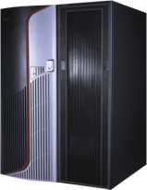

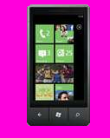

Evolving Integration Needs
2010 Cloud
2000 SOA
1990 Web
1980 Client-Server
1970 Mainframe

Slide 8














Cloud brings new challenges
^{App} ^{services}
How do I build modern apps that connect services with devices
cloud services
caching
identity
service bus
media
mobile services
web sites
BizTalk Services
hpc
analytics
How do I manage data explosion?
^{Data} ^{services}
SQL database
HDInsight
Table
Blob storage
^{Infrastructure} ^{services}
How can my IT infrastructure keep up with my business?
Virtual machines
Virtual network
VPN
Traffic manager
CDN
Notes:
Windows Azure is a broad stack of services that runs in our datacenters globally.
Think of the different services as building blocks. These services can be categorized into three classes –
Infrastructure services which are lower level building blocks,
Data services that provide storage and data management capabilities to apps, and
App services which provide different capabilities to rapidly develop apps, scale and run apps at a global scale.

Slide 9


Cloud brings new challenges
^{App} ^{services}
How do I integrate my enterprise and my business partners?
^{One} ^{Integration} ^{Stack}
How do I build modern apps that connect services with devices
cloud services
caching
identity
service bus
media
Mobile services
BizTalk services
API Mgmt.
mobile services
web sites
BizTalk Services
hpc
analytics
How do I manage data explosion?
^{Data} ^{services}
SQL database
HDInsight
Table
Blob storage
Service bus
Workflow
Active Directory
^{Infrastructure} ^{services}
How can my IT infrastructure keep up with my business?
Virtual machines
Virtual network
VPN
Traffic manager
CDN
Notes:
Windows Azure is a broad stack of services that runs in our datacenters globally.
Think of the different services as building blocks. These services can be categorized into three classes –
Infrastructure services which are lower level building blocks,
Data services that provide storage and data management capabilities to apps, and
App services which provide different capabilities to rapidly develop apps, scale and run apps at a global scale.

Slide 10

OVERWHELMED?
CHALLENGES
Two many Systems
Incompatible Systems
Inconsistent Information
Different data formats
Number of endpoints
Inefficient Processes
Long running operations
Lacks Visibility
Different protocols
Need to Scale
monitoring and management
fault tolerant
retry mechanisms, persistence, backup channels
ALWAYS ON
Notes:
Source: https://www.flickr.com/photos/andresthor/3963368371/

Slide 11
BizTalk Server

Slide 12













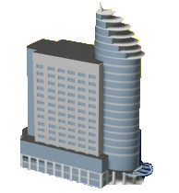





What is BizTalk Server?
Empresa
Fabricante
Revendedor
Fabricante
Distribuidor
Logística
Logística
Escritórios
Fornecedor
Fornecedor
Notes:
Para começar tenho de perguntar aqui quem sabe o que é o BizTalk Server?
Podíamos começar por definir o BizTalk, de uma forma simples, como um router/broker de mensagens
Para fazer uma analogia com o mundo real, como uma plataforma logística de troca de mercadorias.
As matérias primas entram nas empresas, são armazenadas, processadas, transformadas e enviadas aos clientes.
E da mesma forma as mensagens electrónicas são…

Slide 13

What is BizTalk Server?
EAI / BPM
Notes:
Recebidas, validadas, arquivadas, transformadas e enviadas para outros sistemas.
Nestes processos, o problema é a quantidade de novas ligações que é preciso manter a funcionar durante muitos anos.
Ao mesmo tempo novos processos são adicionados e os existentes vão sofrendo pequenas melhorias, tudo sem perder o rasto ao que está a acontecer em produtivo.
O BizTalk ajuda-nos a resolver muitos destes problemas, resolvendo automaticamente questões como a persistência, tracking de todas as mensagens, tratamento e recuperação de erros, suporte a transacções, encriptação e assinaturas digitais, os processos asyncronos de workflow, etc…
Para além disto tudo, esta plataforma já tem mais de 10 anos (Microsoft BizTalk Server 2010 é a sétima versão do produto) e portanto é uma plataforma madura e com muitos componentes 3rd-Party (mais de 25 adaptadores multiplataforma) para ligação a sistemas como o SAP, Oracle, Siebel, SQL, etc…
Gostava de frisar aqui um ponto: um dos desafios que se colocam nestes cenários é exactamente a transformação de documentos…

Slide 14
BizTalk Server Capabilities
Management and Operations
Business Rule Framework
Business to Business Integration
Business Activity Monitoring
Orchestration
Cloud Integration
Messaging
Tools
RFID Platform
Notes:
Messaging: Inbound, Outbound, Durable Messaging, Message Security, Message Assembly/Disassembly, Pluggable Adapters, Message Security, Message Assembly/Disassembly, Pluggable Adapters, Enterprise Single Sign-On, Service Enablement
• Web Services based messaging (WS* standards)Windows® Communication Foundation (WCF) Adapters • WCF-BasicHttp • WCF-WsHttp • WCF-NetTcp • WCF-NetMsmq
Orchestration: Flow Control, Port Bindings, Scopes, Design Patterns
• Asynchronous Response Correlation • Aggregator • Composed Message Processor • Dynamic Router • Parallel Convoy • Scatter and Gather • Sequential Convoy • Splitter
Business to Business Integration: Trading Partner Management, EDI Support, AS2 Support, Industry Accelerators • SWIFT • HL7 • RosettaNet
Business Rule Framework: Business Rule Engine, Business Rule Authoring
Business Activity Monitoring: Observation Model Design, Event Observation Engine, Reporting
Management & Operations: Application Management, Tracking Configuration & Reporting, Host Management, Application Deployment, Best Practices Analysis, MOM Monitoring, Data Management
AppFabric Connect Integration: Line of Business Applications (LOB) activities (Consume LOB operations as Windows Workflow Foundation (WF) activities), Mapper Activity (Transformation as a WF activity)
RFID Platform
Tools
• Schema Editor
• Flat File Schema Wizard
• Mapper
• Pipeline Designer
• Orchestration Designer
• WCF Service Publishing Wizard
• Administration Console
• MOM Management Pack
• Best Practices Analyzer
• Business Rule Composer
• Policy Deployment Wizard
• Orchestration Designer for Business Analysts
• Observation Model Designer
• Tracking Profile Editor
• BAM Portal
• BAM Manager
• EDI User Friendly Schema Viewer
• EDI Document Instance Generation/Validation
• Trading Partner Portal
• RFID Manager
• RFID Tray
• RFID Event Simulator
• RFID Client Console

Slide 15




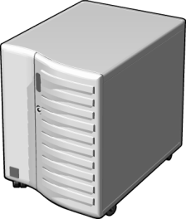

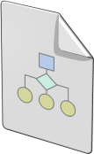
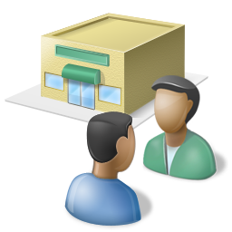
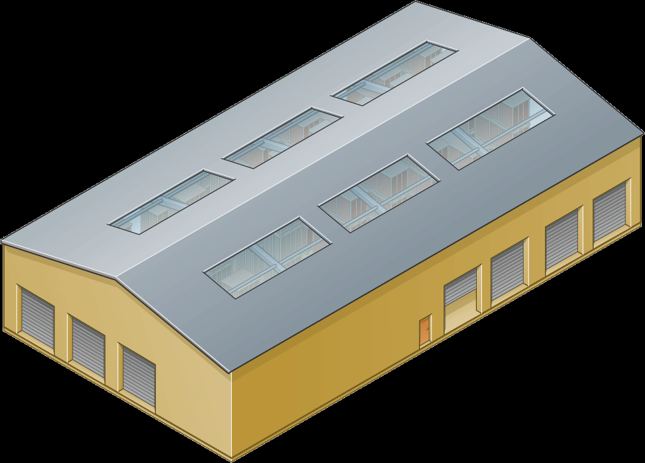
BizTalk Server Integration Scenario
RFI
Filter Tags
Policy
Read Shipment RFID Tags
5
Microsoft BizTalk Server 2010
Inventory Application
Messaging
Manage and
Operate
Re-stock Orders
Orchestration
1
EDI
IT Pros and Developers
4
Design and Implement
Messaging
Assign Supplier
Policy
Up-to-date KPIs in BAM
Suppliers Application
Messaging
2
3
Business
Users
Enterprise Resource Planning (ERP) Application
Notes:
Neste cenário, um aplicativo de inventário, talvez a correr num mainframe, determina que o stock de um item é baixa e emite um pedido para pedir mais desse item. Ocorrem as seguintes etapas:
The request is sent to a BizTalk Server 2010 application
The BizTalk application requests a purchase order (PO) from the organization’s Enterprise Resource Planning (ERP) application.
The ERP application, which might be running on a UNIX system, sends back the requested PO.
The BizTalk application informs a fulfillment application, built on the Microsoft .NET Framework, that the item should be ordered
Neste exemplo, cada aplicação comunica por meio de um protocolo diferente, utilizando os formatos de mensagens específicas de cada aplicação. Isto significa que o mecanismo de mensagens do BizTalk deve ser capaz de se comunicar com cada aplicativo no seu protocolo de comunicação e formato nativo e também converter as mensagens para o protocolo e formato exigido pelos demais sistemas.

Slide 16


BizTalk Server Logical Architecture
XML EDI or Flat File
XML EDI or Flat File
Receive Port
Orchestration
Send Port
Receive Adapter
Receive Location
Send Adapter
Receive Pipeline
Send Pipeline
Mapping
Mapping
FROM: Contoso (Flat file format)
TO: NWTraders (Flat file format)
MessageBox
TO: Fabrikam (XML format)
FROM: Fabrikam (XML format)
Notes:
The two main services in BizTalk Server 2010, the messaging engine and the orchestration engine
O objetivo do BizTalk é processar mensagens. Toda a comunicação dentro e entre um servidor de BizTalk são baseados na troca de mensagens. Por esse motivo, o mecanismo de mensagens é essencial para todas as operações do BizTalk.
The BizTalk messaging engine performs the following tasks:
Receives inbound messages
Parses inbound documents to identify their specific formats
Extracts key identifiers and identifies applicable routing rules
Delivers documents to their respective destinations including ports or orchestrations
Tracks documents
Message database
The MessageBox database is a Microsoft SQL Server™ database that is used by BizTalk to store and route messages to orchestrations and send ports. When a message arrives in the MessageBox database, the metadata associated with the message is matched and evaluated to determine the services that subscribe to messages of this type.
Publish-Subscribe Model
BizTalk Server implements a publish-subscribe model for the routing of messages. In the publish-subscribe model, message providers (publishers) submit messages to a central store (the MessageBox), where subscribers (send ports and orchestrations) can subscribe to specific messages. After a message of interest is received by the MessageBox, it is sent to all subscribers

Slide 17
BizTalk Services

Slide 18

VETER
Transform
Connect LOB
EAI Capabilities
Enterprise Application Integration (EAI) which provide rich message processing capabilities and the ability to connect private cloud assets to the public cloud.

Slide 19

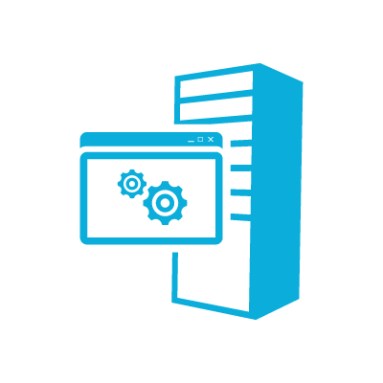




EAI – Incident Management Scenario
Web
Service
Bridge
User 1 via phone
customerType == “VIP”
EAI Bridge
(routing based on condition)
User 2 via online
LOB Relay
Behind Constoso’s Firewall
Partners
FTP Shares could be on-premise or in Cloud
customerType == “Default”
Service Bus Connect
Line of Business System
Validate – Enrich – Transform – Enrich - Route (VETER)
FTP Share 1
LOB Target
FTP Share 2

Slide 20


B2B comm
Portal
EDI Capabilities
Electronic Data Interchange (EDI) targeted at business-to-business (B2B) scenarios in the form of a finished service built for trading partner management.

Slide 21

EDI Service Order Processing Scenario
TPM Portal
EDI App
EDI
EDI Bridge
Service Bus
Hybrid Connectivity
TPM
AS2
BAM
Orders
EDIFACT
X12
FTP
10.000+ EDI schemas
Sales Dashboard
(ASP .NET)
Order Management LOB System
Northwind
Contoso

Slide 22
Microsoft Azure BizTalk Services
Mgmt./tools/infra.
On-demand, per tenant, dedicated deployment that provides isolation and predictable performance
Easy provisioning
Disaster recovery
Backup and restore
Programmatic access to management functions
Schema editor/test map in VS
Bridge configuration surface
Mapper Migration Tool Agreement Migration Tool
EAI
Transport adapters for FTP/FTPs, SFTP, HTTP
Hybrid connectivity to SQL, SAP, Oracle EBS, Oracle DB
Content based routing to Web services, SB queues, topics, relays
Transformation engine
Out-of-box integration pattern
Custom code in Bridge
B2B
EDI AS2 and X12
Trading Partner Management
Agreements config templates
EDI batching
Tracking
Archiving with NRR
TPM OM API
Notes:
We have release bizTalk services GA today. It is the first version of bizTalk service available to customer. As you saw it already has customers going live on it and using it for their business needs
This BizTalk service is built from ground up for enterprise needs. There were forefront our thought. It is the first service to use dedicated managed approapch. When we talked to lot of enterprise customer Isolation, resource gurantees were at the forefront. This is because Biztalk runs mission critical workloads. Out new managed dedicated infrastructure combines benefits of managed service with benefits of dedicated environements. Provisioning a biztalk environment has never been easier. You go through portal and click through the wizard and you are ready to configure.
We have also made tooling improvements in the schema editor and testing map functionality for developers. Since all of you have biztalk servier, we have also introduced tools for migrating biztalk maps to services and tool for migrating trading partner agrements
It currently supports two scenarios of EAI and EDI. In EAI we have build a new transformation engine. We also allow connecting to data sources using various protocols FTP/FTPS/SFTP/HTTP. As I said earlier, we will be focusing on hybrid scnearios as we believe it will be a reality for long time. Using BizTalk adapter services, you connect to your on-premise systems and using cloud to integrate. we provide out of box connectivity to popular on-premise systems such as SAP, SQL, Oracle EBS.
Since we think B2B scenarios are amenable to cloud, we have done some major improvments in B2B. It supports X12/AS2, TPM portal and APIs . This is an enterprise class B2B solution that we belive customers will love.

Slide 23


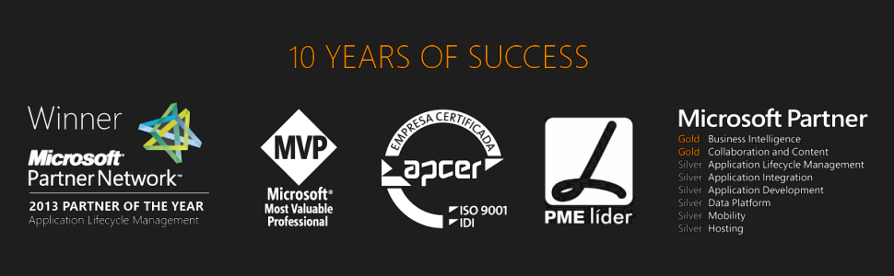



Questions?
sandro.pereira@devscope.net
linkedin.com/in/sandropereira
@sandro_asp
sandroaspbiztalkblog.wordpress.com
www.devscope.net

